Slide 1
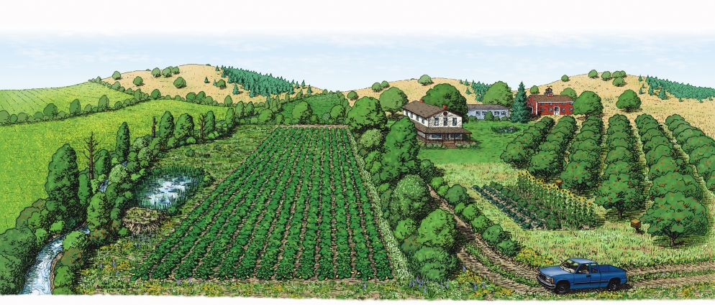
A Whole Farm Approach
For Integrated Pest Management
Norm Leppla
UF, IFAS, IPM Program Director
Andrew Holder Xerces Society

Slide 2
FLORIDA EXTENSION INITIATIVE 1: INCREASING THE SUSTAINABILITY, PROFITABILITY, AND COMPETITIVENESS OF AGRICULTURAL AND HORTICULTURAL ENTERPRISES
STATEWIDE EDUCATIONAL PROGRAMS for “Sustainability of Production Systems and Alternatives”
Sub-action plans:
Food Systems and Food Security
Animal Systems
Plant Systems
Integrated Pest Management (IPM)

Slide 3
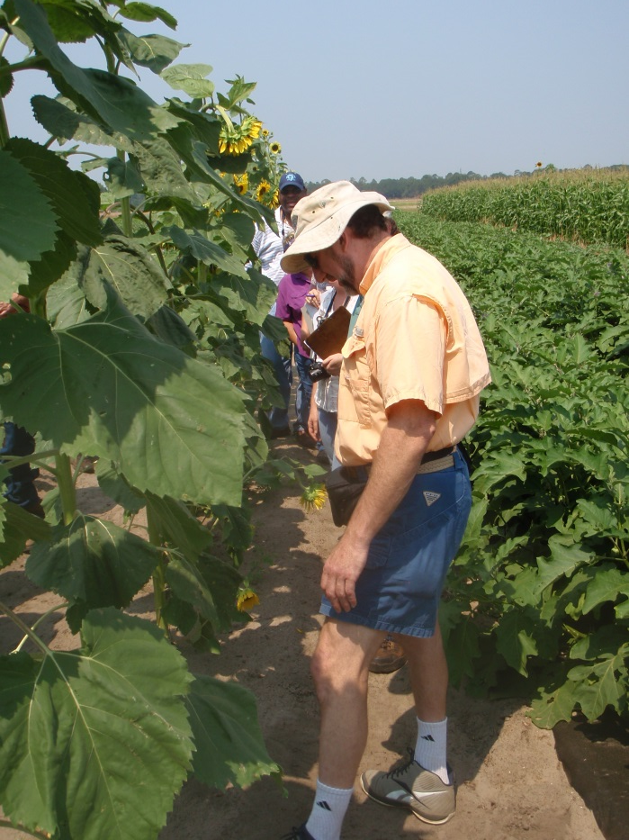
Integrated Pest Management (IPM)
Pest diagnostics and management. Develop and implement improved methods for detecting, identifying, reporting, and managing invasive species (insects and other arthropods, pathogens, weeds and other pests).
IPM systems. Develop IPM systems for entire sites, e.g., farms and ranches, neighborhoods, municipalities, etc., that increase adoption of intelligent pest management strategies.
Education and training. Increase the adoption of IPM practices by Florida farmers and ranchers, property and municipal managers, and others by expanding delivery of the required education and training.

Slide 4
SUPER ISSUES
Enhance the Statewide IPM Program (IPM Florida) to adequately address critical needs and significantly increase the awareness, appreciation and adoption of IPM options for protecting food systems and the environment.
Realize the potential for IPM to enhance resource sustainability and conservation in Florida communities.
Increase collaboration between state specialists and county Extension faculty.

Slide 5
Crop ecology
Biologically diversified farming systems
Farmscaping: Making Use of Nature’s Pest Management Services
Landscape ecology
Holistic approach to farming
Geoff Zehnder, IPM Coordinator, Clemson University
Sustainable agriculture
Agroecology
Farmscaping is a whole-farm, ecological approach to increase and manage biodiversity with the goal of increasing the presence of beneficial organisms.
Ecoagriculture

Slide 6
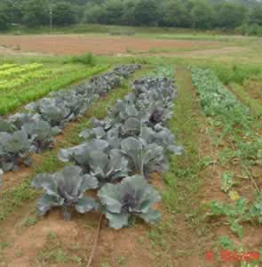
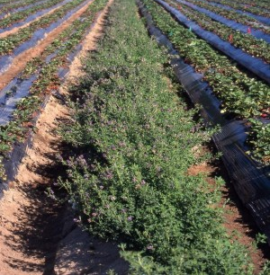
Farmscape Planning
Keep good records of where, when, and what pests occur on the farm.
Gather information about key pest and natural enemy life cycles and habitat requirements.
Make a list of available strategies that can be implemented to create a habitat for the beneficials (insectary plants), and a more unfriendly habitat for pests (trap crops).
Select a combination of strategies that best fit your farm plan (i.e., location of your fields, crops grown and rotation plans, available equipment and labor).
Choose appropriate annual and perennial insectary plants.
Observe and keep records of the results; experiment with different strategies and fine tune the system.
Start simple and small, then develop and expand the farmscape based on observations and results.
Lettuce, cabbage & sunflower
Alfalfa and strawberries, Sean Swezey, U. California

Slide 7
The application of ecology to the design and management of sustainable agroecosystems.
A whole-systems approach to agriculture and food systems development based on traditional knowledge, alternative agriculture, and local food system experiences.
Linking ecology, culture, economics, and society to sustain agricultural production, healthy environments, and viable food and farming communities.
Ecology is the scientific study of interactions among organisms and their environment

Slide 8
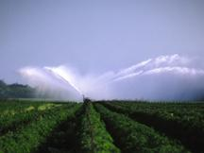
Sustainability of Agriculture
Economic profitability
Environmental resources & health
Social and economic well-being

Slide 9
Holistic Approach to Farming
Social Political
& Regulatory Environment
Crop Ecology
&
Management
Market
Farm Size, Labor, Capital Debt, Land
Efficiencies &
Cost of Production
Soil Health
Materials Containment
Soil
Residues
Nutrients
Pesticides
Physical
&
Biological Environment
Whole Farm Integrated Pest Management
Return
Landscape Ecology
R. R. Harwood Michigan State University Extension

Slide 10
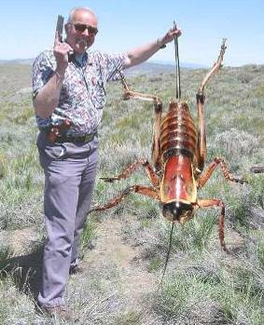
What is IPM?
It coordinates the use of pest biology, environmental information, and available technology to prevent unacceptable levels of pest damage by the most economical means, while posing the least possible risk to people, property, resources, and the environment.

Slide 11
Generic IPM Program
Biological knowledge
Monitoring and inspection
Act to control pests when necessary
Choose least-risk options
Long-term, preventative practices
Evaluation and records
Pesticide management
Continual improvement

Slide 12
IPM System
Pest outbreaks & disease epidemics
Environmental contamination
Human health hazards
Pest mgmt. costs
Reduce risks
INCREASE…
Reliability
Sustainability
Chem
Biological Control
Cultural Methods

Slide 13
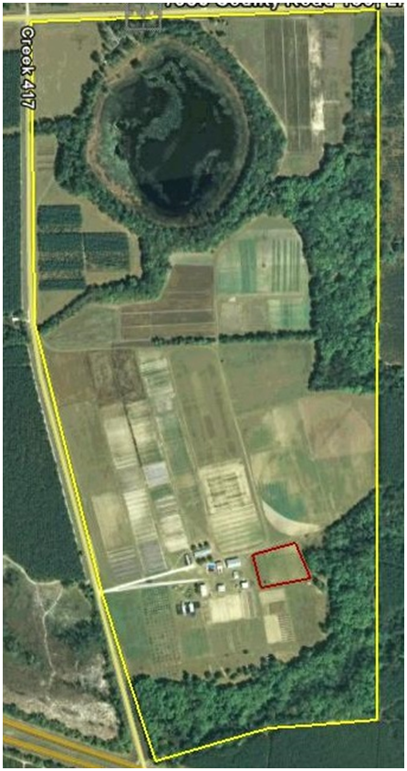
Farmscaping- A Whole Farm Approach
For Integrated Pest Management
What is Farmscaping and Whole Farm IPM?
Developing a Year Round Habitat of “Plants with a Purpose”
Protecting and Enhancing Honeybees and Native Pollinators
Vertebrate Predators (Birds, Bats, and Owls)
Specific Management Strategies
Trolley Tour of the Center’s “Farmscape”
Monitoring and Scouting for Vegetable Crops
Good Bug, Bad Bug Identification Hands-on Microscope Activity
Cover Crops, Agronomic Crop IPM Practices and Whole Farm Weed Management Strategies
Putting it all Together

Slide 14
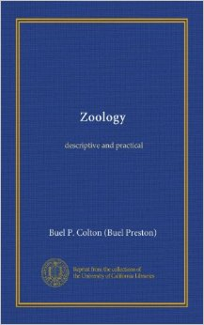
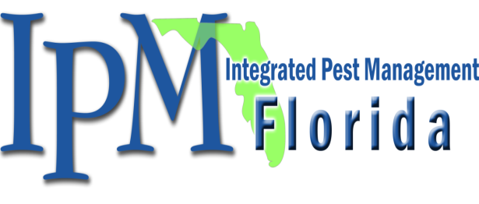
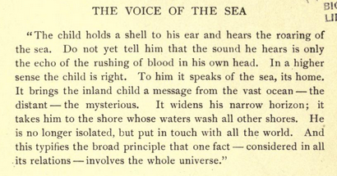
http://ipm.ifas.ufl.edu
Buel P. Colton 1907

